Slide 1
Dashboard
File created on: 1/3/2023 7:33:55 PM

Slide 2
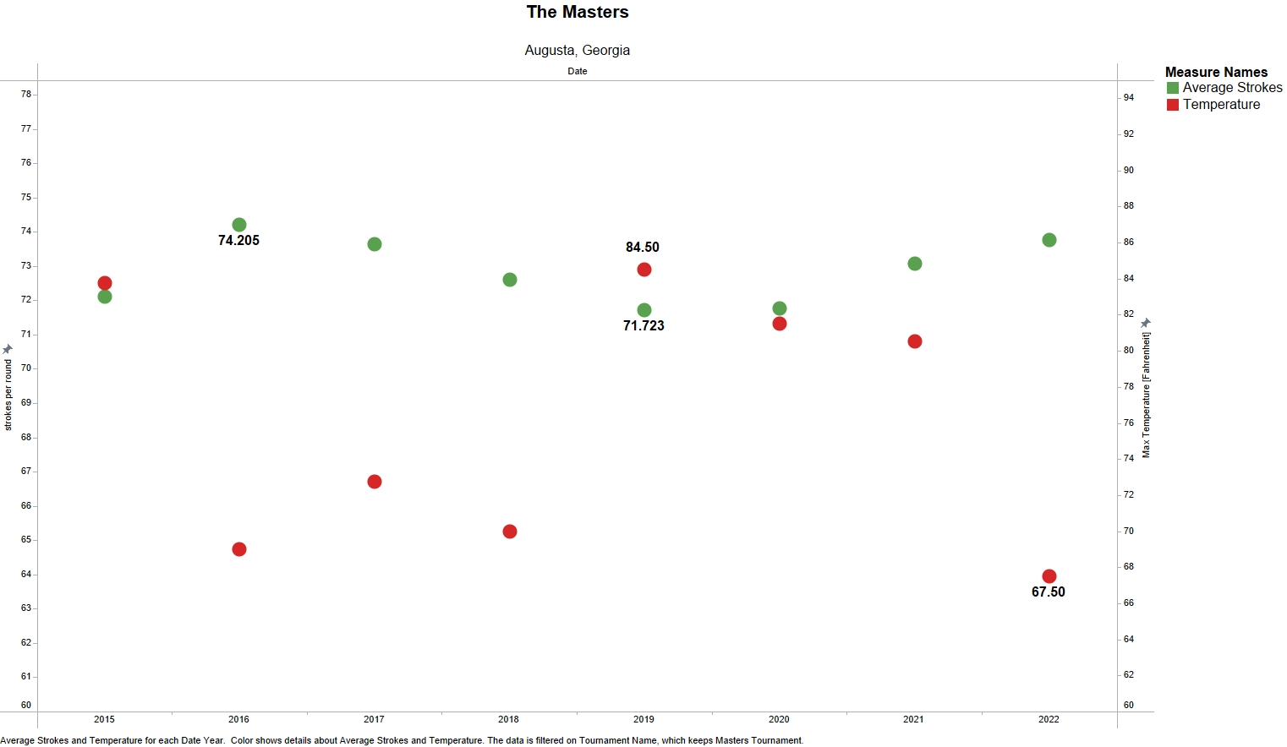

Slide 3
